Slide 1
Topic 5 : Indexes
SECP3623 DATABASE PROGRAMMING

Slide 2
Learning Outcomes
By the end of this lecture, students should be able to:
Indexing in SQL
What is Indexes
Types of Indexes (B-Tree Index, Bitmap Index, Text index)
Index Creation
Advantages & Limitations of Indexes
Constraints
What is Constraint
Types of Constraints (Primary Key, Foreign Key, Unique, Check)
Creation of Constraints
Examples

Slide 3


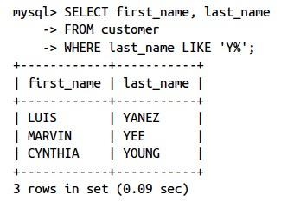
Some limitations when query…
Existing table
Limitation: When the number of rows is large, i.e., in millions, this could be a time-consuming task
SEARCH
table scan
when query the database, the server will need to inspect every row to answer the query
new data
Example:
new data inserted / appended to the next available location regardless of order from any columns
The server need to do a table scan on each rows for the content of column last_name if the content begins with Y and add to the result set.

Slide 4
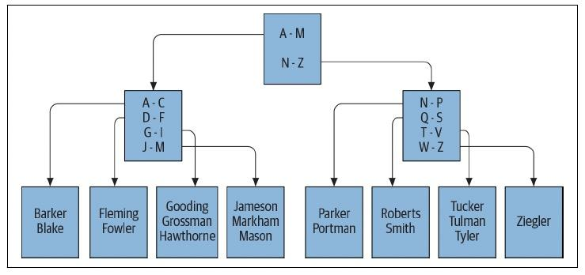
What is Indexes?
A database server uses indexes to locate rows in a table.
Indexes are special tables that kept in specific order according to the specific columns that can used to locate the rows in the original table.
Role of index: to facilitate the retrieval of a subset of table’s row without need to inspect every row in table.
Index to help faster locate of rows
 |  |  | last_name
 |  |  | Fleming
 |  |  | Barker
 |  |  | Roberts

Slide 5
Index Creation
NOTE: To check for existing index in a table can use following command:
SHOW INDEX FROM <table>
Indexes can be created during the creation of table, or post creation of table (through alter table)
<table>
<column for index>
Adding index in existing table
ALTER TABLE customer
ADD INDEX idx_email (email);
<index_name>
Define index during table creation
CREATE TABLE customer(
...
...
PRIMARY KEY (customer_id),
KEY idx_fk_store_id (store_id),
KEY id_fk_address_id (address_id),
KEY idx_last_name (last_name)
)
define other indexes using KEY keyword
primary key will generate one index named primary
NOTE: To drop existing index in a table in MySQL: ALTER TABLE <table> DROP INDEX <index name>

Slide 6
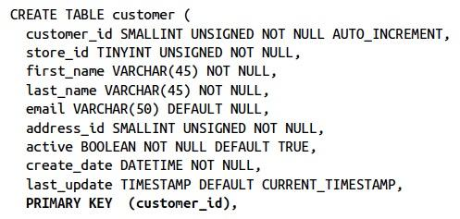


Unique indexes
This add UNIQUE constraint and create a unique index on customer.email column.
serves as a mechanism for disallowing duplicate values in the indexed column.
Whenever a row is inserted or when the indexed column is modified, the database server checks the unique index to see whether the value already exists in another row in the table.
Does not have any UNIQUE constraints

Slide 7
Multicolumn indexes
You may also build indexes that span multiple columns. If, for example, you find yourself searching for customers by first and last names, you can build an index on both columns together
Reminder: When building multiple-column indexes, therefore, you should think carefully about which column to list first, which column to list second, and so on, to help make the index as useful as possible.
You can also make multiple indexes based on same set of columns but in different orders if needed.
The order matters!!
In this case, this index will be useful for queries that specify:
1. the first and last name
2. just the last name
last_name | first_name
Alan | Brown
Alan | Kahn
… | ,,,
… | ,,,
Note: It would not be useful for queries that specify only first name. If use only first name, the server will still need to scan every entry to find matching first name.
index

Slide 8
Types of Indexes
B-Tree Indexes
Bitmap Indexes
Text Indexes
Known as balanced-tree indexing.
Default index type in MySQL, Oracle and SQL Server, unless you explicitly ask for other type.
Organized as tree structure, with multiple levels of branch nodes
Suitable for columns that contain only small number of values across large number of rows (low-cardinality data)
Commonly used in data warehousing environments, where large amounts of data are generally indexed on columns containing relatively few values.
Specialized indexing and search mechanisms for documents.
This applies only if your database stores documents.

Slide 9
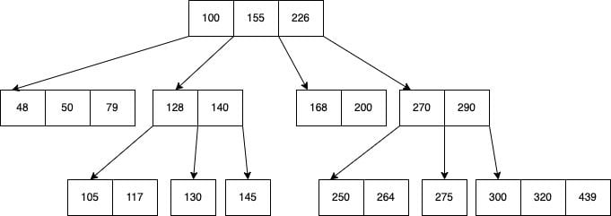
B-tree index
B-tree is a data structure that provides sorted data and allows searches, sequential access, attachments and removals in sorted order.
B-tree is highly capable of storing systems that write large blocks of data.
B-tree simplifies the binary search tree by allowing nodes with more than two children. Below is a B-tree example.
Stores data such that each node contains keys in ascending order.
Each of these keys has two references to another two child nodes.
The left-side child node keys are less than the current keys, and the right-side child node keys are more than the current keys.
If a single node has “n” number of keys, then it can have maximum “n+1” child nodes.

Slide 10
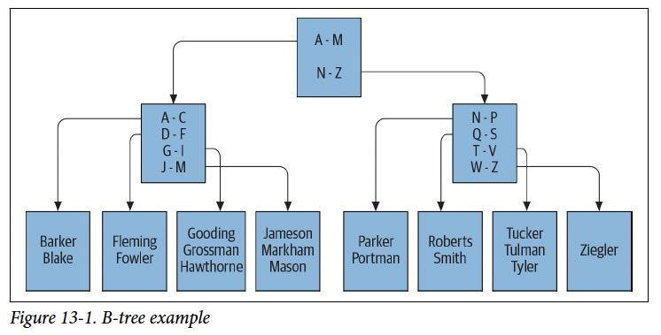
B-tree index
If issue a query to retrieve all customer whose last name starts with G,
the server would look at the top branch node (root node) and follow left node that handles last names beginning with A through M,
then direct to a leaf node containing last names beginning with G through I.
Then server starts reading values in the leaf node until it encounter a value doesn’t begin with G.

Slide 11
Bitmap indexes
Bitmap combines two words: Bit and Map.
A bit represents the smallest unit of data in a computer, which can only hold a value of either 0 or 1.
A map refers to the process of transforming and organizing data according to what value should be assigned to 0 and 1.
Designed to improve query performance on low-cardinality scalar fields. Cardinality refers to the number of distinct values in a field. Fields with fewer distinct elements are considered low-cardinality.
This index type helps reduce the retrieval time of scalar queries by representing field values in a compact binary format and performing efficient bitwise operations on them.
Consists of two main components: bitmaps and keys. Keys represent the unique values in the indexed field. For each unique value, there is a corresponding bitmap. The length of these bitmaps is equal to the number of records in the collection.
Each bit in the bitmap corresponds to a record in the collection. If the value of the indexed field in a record matches the key, the corresponding bit is set to 1; otherwise, it is set to 0.

Slide 12
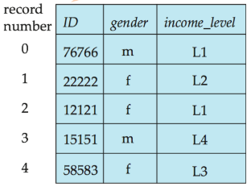
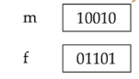
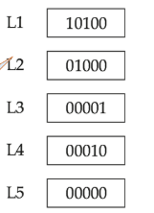
Bitmap indexes
2 values of gender index
5 bits means 5 rows in table
5 income levels
5 bits means 5 rows in table
Table
BITMAPS for gender
BITMAPS for income_level
CREATE BITMAP INDEX <indexname> ON
<table>
(x, y);

Slide 13
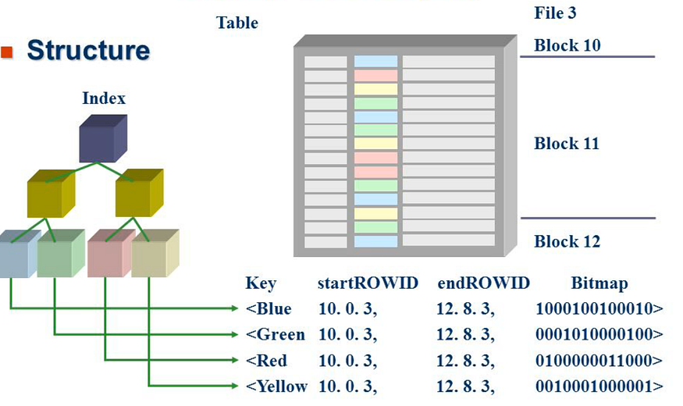
Bitmap indexes

Slide 14
Text indexes
Text Indexing (or Full-Text Indexing) is the process of creating data structures such as inverted indexes that map terms (words) to their locations in text fields or documents. This allows the database to perform sub-second keyword or phrase searches across large text datasets, making it essential for efficient information retrieval.
A text index is a specialized database index built to support efficient searching within text-based columns or fields, rather than just exact matches or numeric lookups. It enables operations like full-text search, keyword search, phrase matching and relevance ranking.
Standard database indexes work well for exact or range queries on structured data but perform poorly when you want to search for words inside large text fields (examples, articles, comments).
A text index allows queries such as “find all documents where the word ‘climate’ appears” or “find all records containing the phrase ‘machine learning’”.
With large volumes of text (logs, articles, user posts), text indexing is essential for interactive performance.

Slide 15
Text indexes
This creates a table named product with three columns:
product_id — a unique identifier for each product (primary key).
name — stores the product name (short text).
description — a longer text field where you store detailed product info.
Full-text indexes are meant for large text columns (CHAR, VARCHAR, or TEXT) where word-based searching is needed.
-- Create table
CREATE TABLE product (
product_id INT PRIMARY KEY,
name VARCHAR(100),
description TEXT
);
-- Create a text index
CREATE FULLTEXT INDEX ft_description ON
product(desc);
-- Query using text search
SELECT * FROM product
WHERE MATCH(desc)
AGAINST
('wireless fan' IN NATURAL LANGUAGE MODE);
This command creates a Full-Text Index named ft_desc on the desc column. This index works differently from normal B-Tree indexes:
It tokenizes the content (splits text into words).
It builds an inverted index mapping each term → product IDs where the term appears.
This allows sub-second keyword searching even in large data.
Without this index, using LIKE '%word%' would scan the entire table for matches very slow.
MATCH() function searches the indexed description column, and AGAINST() specifies the search query.
The query searches for the keywords “wireless” and “fan”.
MySQL uses the full-text index to find all rows where these words appear.
Results are ranked by relevance — rows with both terms appearing more frequently (or closer together) rank higher.
IN NATURAL LANGUAGE MODE means the search behaves like a normal human-language query.

Slide 16
How Indexes works in DB?
Indexes are implemented using data structures like B-trees, which organize the data in a way that reduces the number of steps required to find a particular row. When an index is created on a column, the database engine generates a sorted data structure for that column that enables rapid searching.
When a query is executed, the database checks if an index is available for the specified columns. If it is, the database uses the index to find the data more quickly, as opposed to scanning each row sequentially (a process known as a full table scan).
For example:
Let’s say you have a table called Students with columns such as StudentID, Name, and Department. If you frequently query the StudentID column, creating an index on it will make those queries faster. Instead of searching through each row to find a particular StudentID, the database can use the index, which has already organized StudentID values in a way that makes them easy to locate.

Slide 17
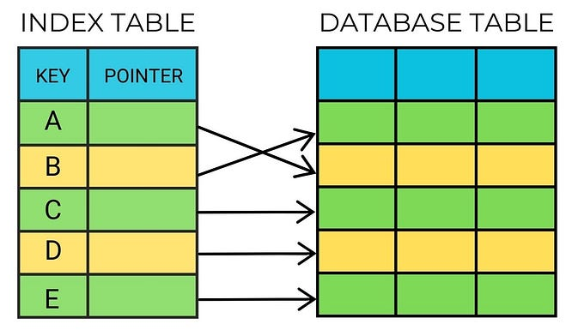
How Indexes works in DB?
An index is a shortcut that helps the database find data quickly without scanning every row.
The index stores a sorted list of values from a column (example: email).
Each entry in the index points to a page where the actual data is stored.
Instead of scanning every row, the database looks at the index first, finds the right page, and jumps directly to it.
HOW INDEXES WORKS IN DB?
Index Creation: The database administrator creates an index on a specific column or set of columns.
Index Building: The database management system builds the index by scanning the table and storing the values of the indexed column(s) along with a pointer to the corresponding data.
Query Execution: When a query is executed, the database engine checks if an index exists for the requested column(s).
Index Search: If an index exists, the database searches the index for the requested data, using the pointers to quickly locate the data.
Data Retrieval: The database retrieves the requested data, using the pointers from the index.
Creating an Index
CREATE INDEX idx_users_email ON users (email);
After creating the index, queries that involve conditions or sorting on the users_email column will be optimized.
SELECT * FROM users WHERE users_email = “ali@graduate.utm.my”

Slide 18
Advantage of Indexes
Query optimization: Indexes make search queries much faster.
Uniqueness: Indexes like primary key index and unique index help to avoid duplicate row data.
Text searching: Users have the opportunity to optimize searching against even large amounts of text located in any field indexed as such.

Slide 19
Limitation of Indexes
Every index created is actually a table (though it is a special type of table).
Every time a row is added to or removed from table, all indexes on that table must be modified and updated. When a row is updated, any indexes on the column(s) that were affected need to be modified as well.
If there are excessive indexes available, to keep all schema objects up-to-date would slow things down.
Indexes also require disk space.
Indexes
update index
disk space
update row
New data inserted

Slide 20
Guidelines to help you strategize…
Make sure all primary key columns are indexed (most servers automatically create unique indexes when you create primary key constraints). For multicolumn primary keys, consider building additional indexes on a subset of the primary key columns or on all the primary key columns but in a different order than the primary key constraint definition.
Build indexes on all columns that are referenced in foreign key constraints. Keep in mind that the server checks to make sure there are no child rows when a parent is deleted, so it must issue a query to search for a particular value in the column. If there’s no index on the column, the entire table must be scanned.
Index any columns that will frequently be used to retrieve data. Most date columns are good candidates, along with short (2- to 50-character) string columns.

Slide 21
Exercise - Indexes
CREATE TABLE customer (
customer_id INT PRIMARY KEY,
first_name VARCHAR(50),
last_name VARCHAR(50),
email VARCHAR(100),
store_id INT
);
1. Create a table customer with the following columns:
Create an index on the last_name column to speed up search operations.
2. Add an index on the email column of the existing customer table.
3. You often search for customers using both first_name and last_name. Create a multi-column index to optimize this query:
ALTER TABLE customer
ADD INDEX idx_email (email);
SELECT * FROM customer
WHERE first_name = 'Ali' AND last_name = ‘Din';
4. For a product table with a description column, create a text index to allow keyword searches:
CREATE TABLE product (
product_id INT PRIMARY KEY,
description TEXT
);

Slide 22
Constraints
Setting restrictions on tables

Slide 23
Types of Constraints
PRIMARY KEY
Identify the column or columns that guarantee uniqueness within a table
Restrict one or more columns to contain only values found in another table’s primary key columns (may also restrict the allowable values in other tables if update cascade or delete cascade rules are established)
FOREIGN KEY
UNIQUE
Restrict one or more columns to contain unique values within a table (primary key constraints are a special type of unique constraint)
CHECK
Restrict the allowable values for a column

Slide 24
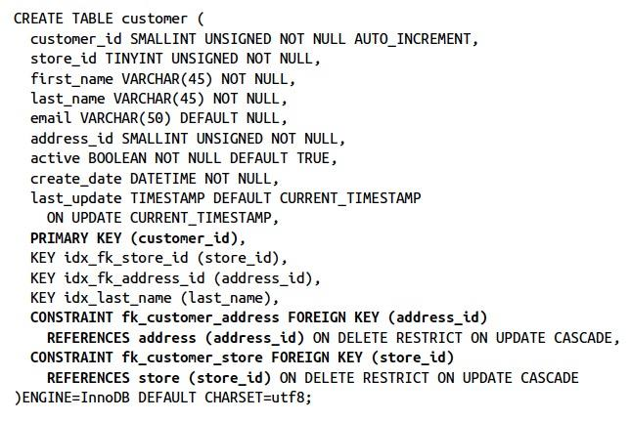
Creation of Constraints
Constraints are generally created when creating tables.
on delete restrict, which will cause the server to raise an error if a row is deleted in the parent table (address or store) that is referenced in the child table (customer)
on update cascade, which will cause the server to propagate a change to the primary key value of a parent table (address or store) to the child table (customer)
primary key
foreign key

Slide 25
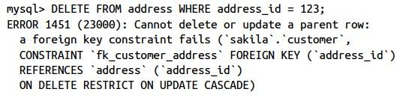
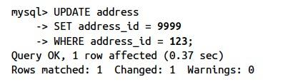
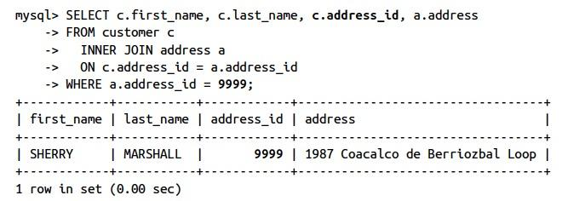
Examples
on delete restrict, which will cause the server to raise an error if a row is deleted in the parent table (address or store) that is referenced in the child table (customer)
on update cascade, which will cause the server to propagate a change to the primary key value of a parent table (address or store) to the child table (customer)
Error will raise when deleting row in parent table.
Update of values in parent table (address table)
the updated value will be cascaded to the child table (customer table)

Slide 26
Options in foreign key constraints
restrict
restrict the deletion of row in parent table
ensure the deletion of primary key in parent table is cascaded to foreign key in child table
on delete
cascade
when row deleted in parent table, child table’s foreign key value set to null
set null
restrict
restrict the update of row in parent table
ensure the updated of primary key in parent table is cascaded to foreign key in child table
on update
cascade
when row updated in parent table, child table’s foreign key value set to null
set null

Slide 27
Exercise - Constraints
CREATE TABLE department (
dept_id INT,
dept_name VARCHAR(50),
location VARCHAR(30)
);
1. Create a table named department with the following structure:
Add a Primary Key constraint to ensure each department is unique.
2. Create a table employee with these columns:
Then link it to the department table so that every dept_id in employee must exist in department.
CREATE TABLE employee (
emp_id INT PRIMARY KEY,
emp_name VARCHAR(50),
dept_id INT
);
3. Ensure that salary values in employee are always greater than 2000.
4. Create the project table with the following rules:
project_id is the primary key.
project_name must be unique.
budget must be more than 10,000.
Each project must be assigned to an existing dept_id from department.

Slide 28
THANK YOU.

